Slide 1
GEneral Introduction
23.10.23
Machine Learning With TensorFlow

Slide 2
Personal Introduction
Organizational Matters
Introductory Discussion on AI
Coursera Registration
Course Projects
ML Frameworks

Slide 3
Personal Introduction
Notes:
Name, Location, Project Interest

Slide 4
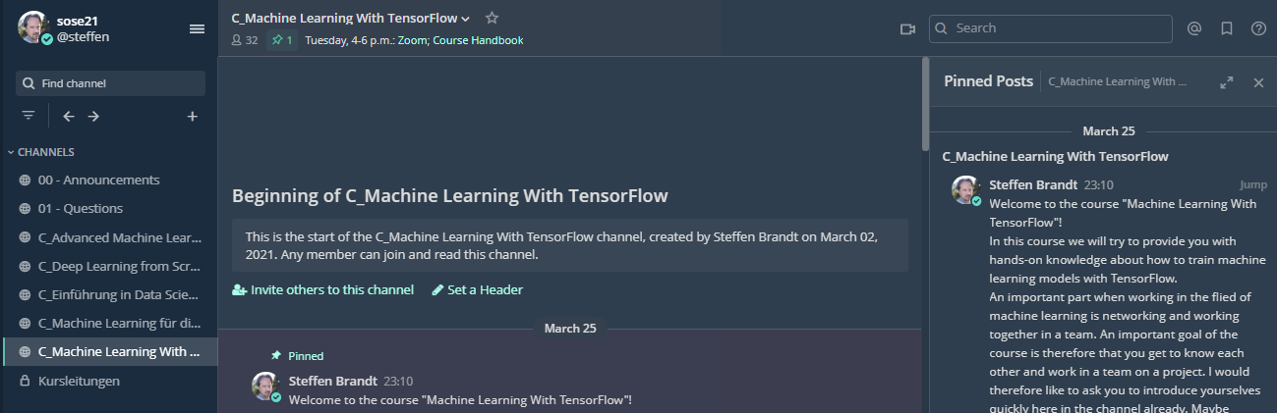
Chat
Please, ask questions to us in the chat

Slide 5
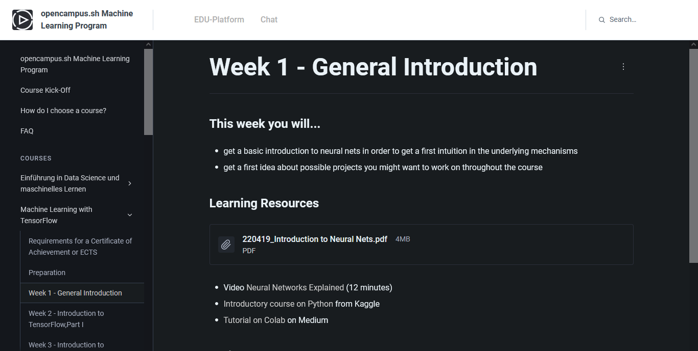
Course handbook

Slide 6
Organizational Matters
Use your full names in the zoom meetings!
Scan the QR-Code if you participate in presence
Complete your profile in the Mattermost chat with your full name and a photo.
Please write us if you will not go on with the course!

Slide 7
Zoom
Try the different viewing modes:
Gallery View/ Active Speaker
Split Screen/ Full Screen Mode
Maybe watch this video to get an idea:
https://www.youtube.com/watch?v=v3IPAbpVjd4

Slide 8
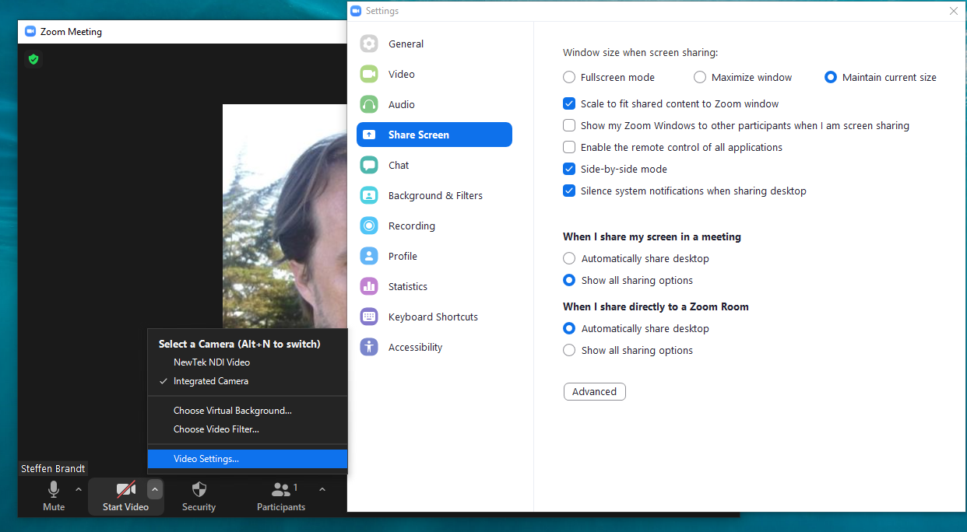

Slide 9
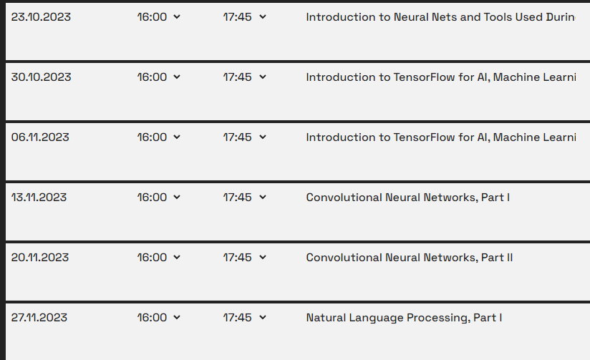
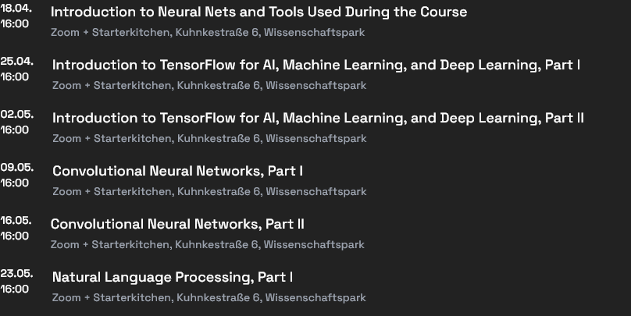
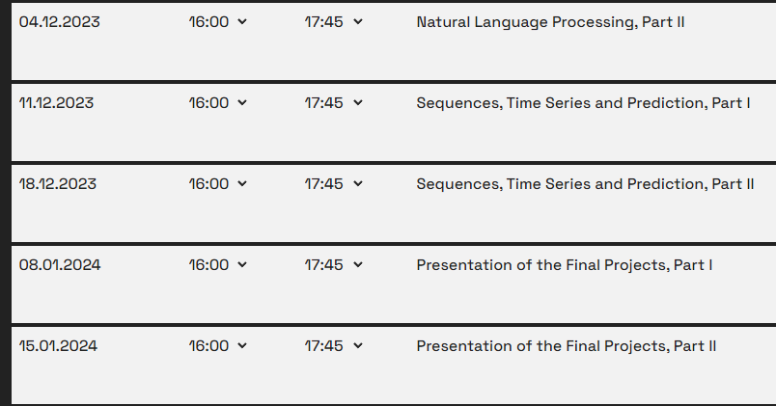
Present your project idea
Notes:
Exchange this slide with a corresponding one from your course and describe in very general terms how the curse is structured. Particulary mention when you would like the participants to have decided on their project and be in a team.

Slide 10
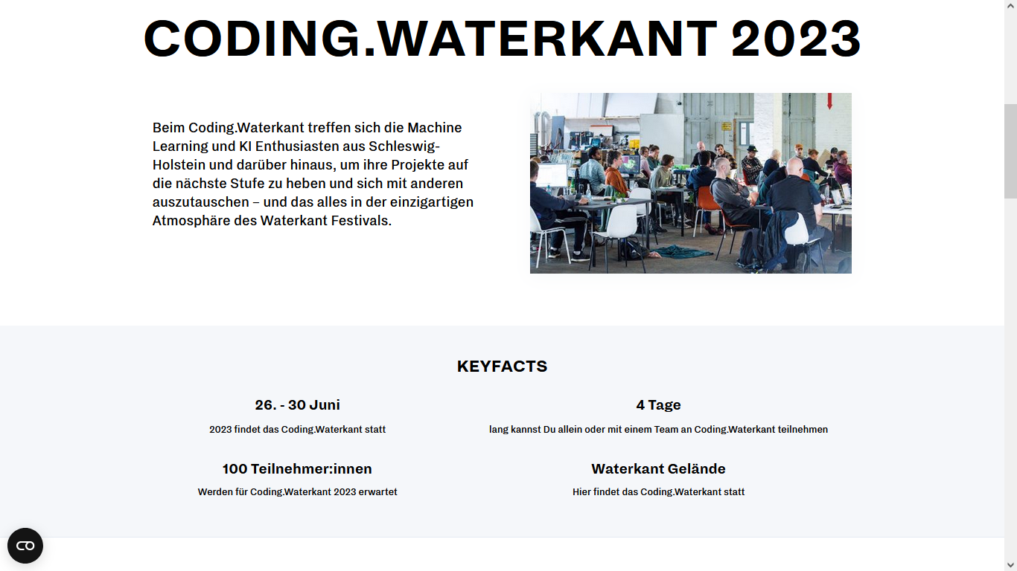
yourself
https://coding.waterkant.sh
Notes:
It would be great if you can share the info on the Coding.Waterkant 2023, which will be at the end of the semester.

Slide 11
Participation Forms
Join a project:
If you want to get further expertise by working on a real-life machine learning project, you can select on Tuesday morning of the event to work on one of the projects that is looking for participants to join them.
Bring your own project:
If you want to work on your own machine learning project during the four days, please, contact us under team@kiel.ai, so we can include your project into the list of participating projects. If you are interested in support for your project you can decide to invite other participants to join your project during the four days.

Slide 12
First Breakout
15-20 Minutes
Present yourself
Discussion Questions:
Do you know examples for Machine Learning?
Do you know examples for Deep Learning?
Are there AI tools that you use?(Chat GPT etc.)

Slide 13
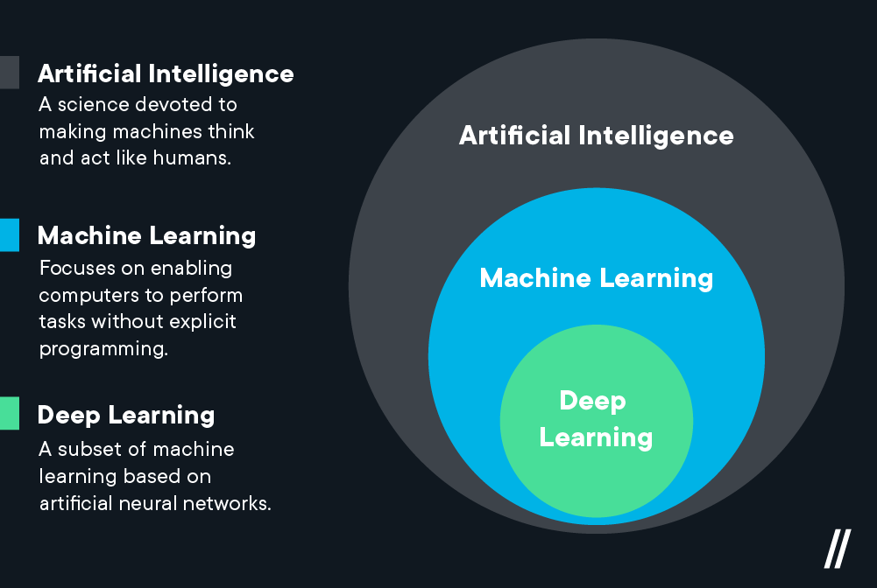
Deep Learning vs. Machine Learning—What’s the Difference? (2021, February 8). Flatiron School. https://flatironschool.com/blog/deep-learning-vs-machine-learning/

Slide 14
Intro to Neural nets
The linked videos are good to get an overview
Don´t be intimidated if you didn´t understand everything
Watch the videos again at a later stage and see if you understand more

Slide 15
“What's the difference between data science, machine learning, and artificial intelligence?”
http://varianceexplained.org/r/ds-ml-ai
Data science produces insights.
Machine learning produces predictions.
Artificial intelligence produces actions.

Slide 16
Artificial Intelligence
„an autonomous agent executes or recommends actions“
(Poole, Mackworth, & Goebel, 1998)
„Systems with 'intelligent' behavior that analyze their environment and act with a certain degree of autonomy to achieve certain goals. “
(European Commission, 2018)
„By artificial intelligence we mean highly developed software systems that are capable of learning and training to master complex tasks.“
(AI-Strategy of the State Schleswig-Holstein, 2019)
Notes:
Es gibt keine Definition von KI!

Slide 17
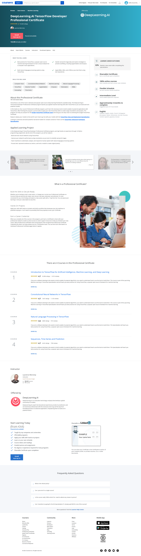
Do NOT try to enroll for the Certificate Program!

Slide 18
Click here!

Slide 19
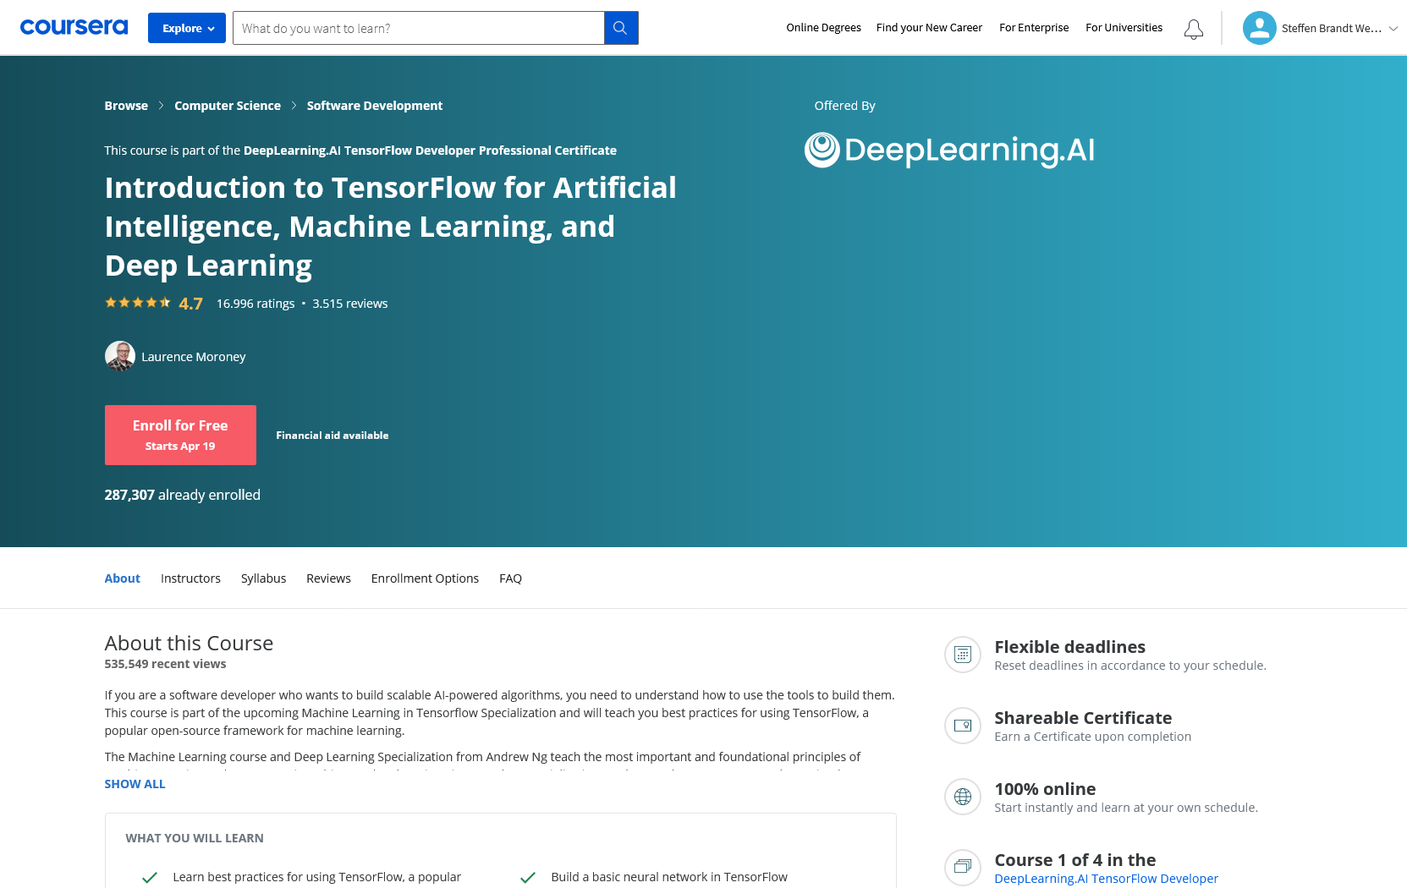
Click here!

Slide 20
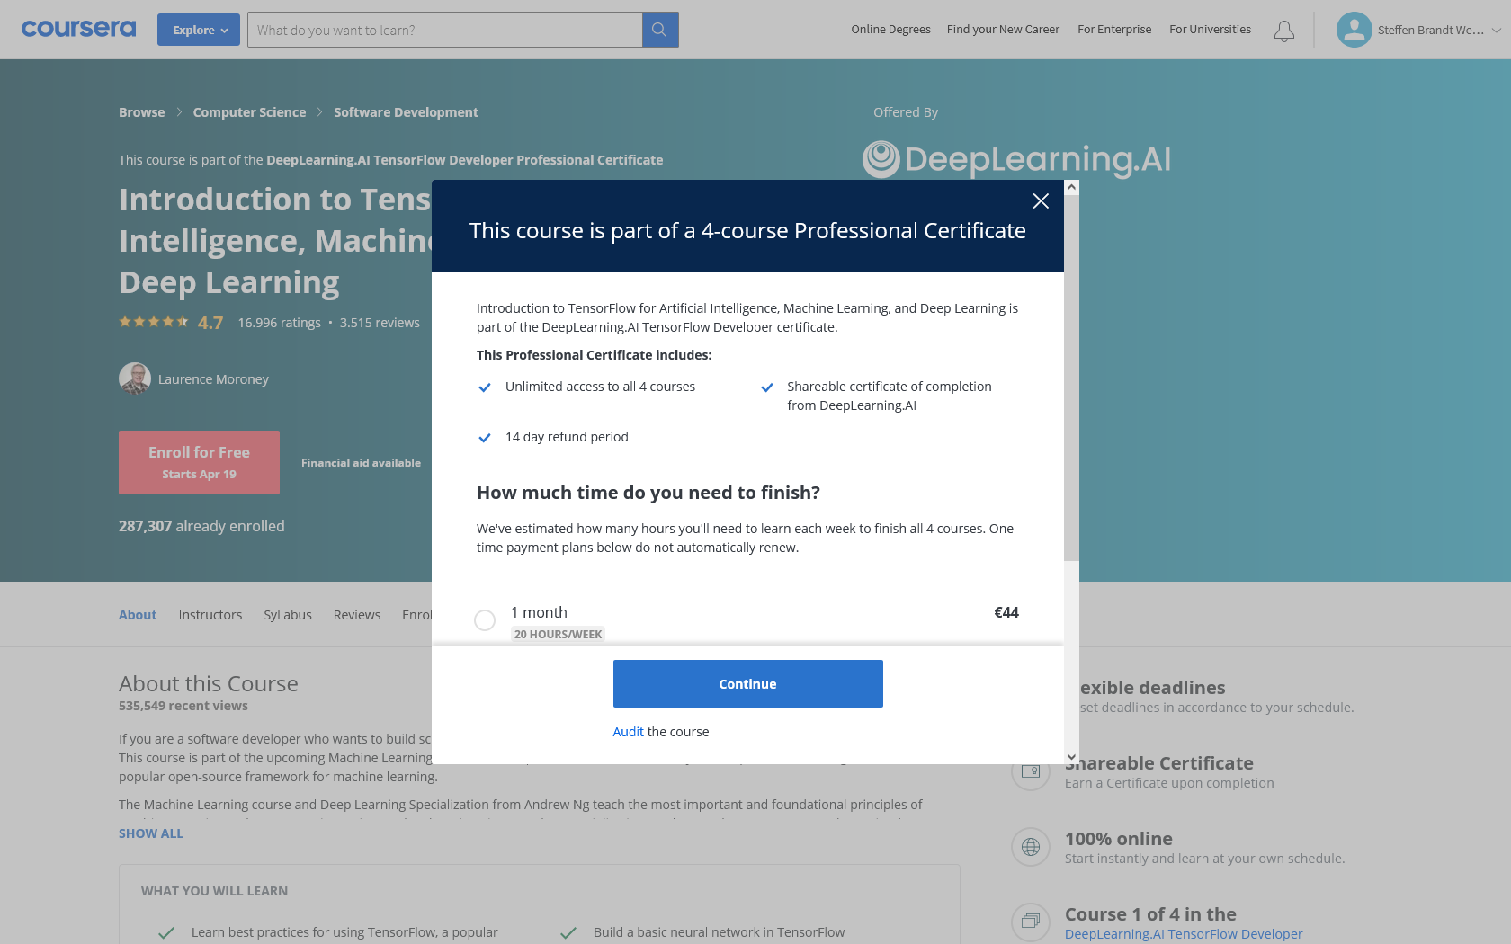
Enroll here!

Slide 21
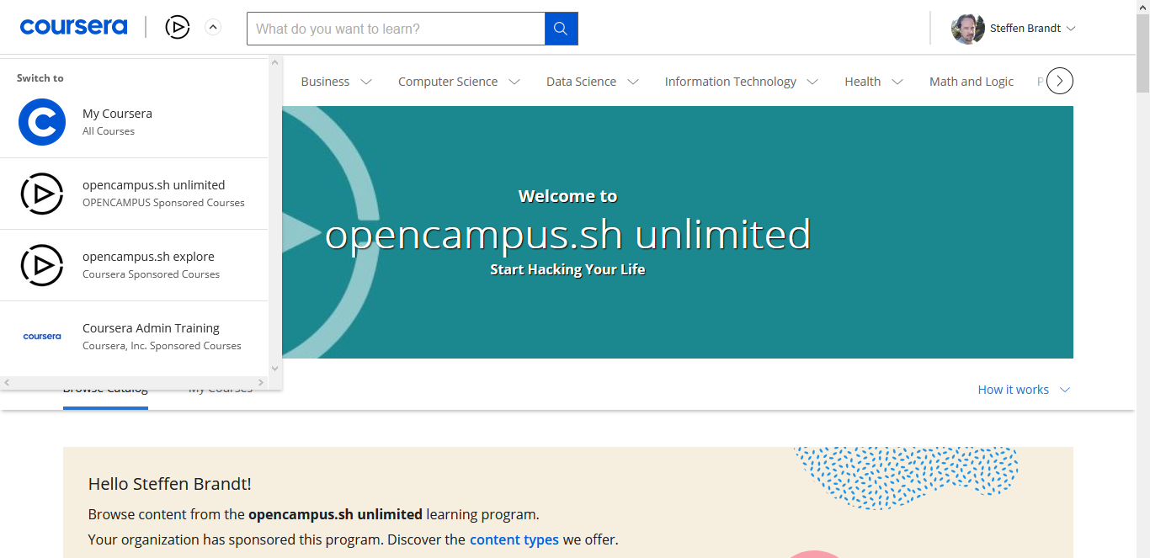
Coursera Registration

Slide 22
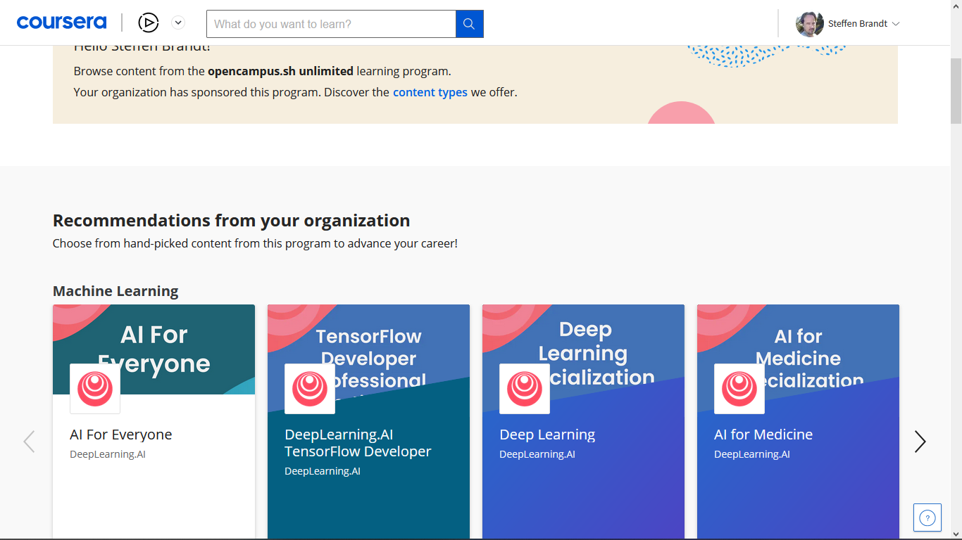

Slide 23
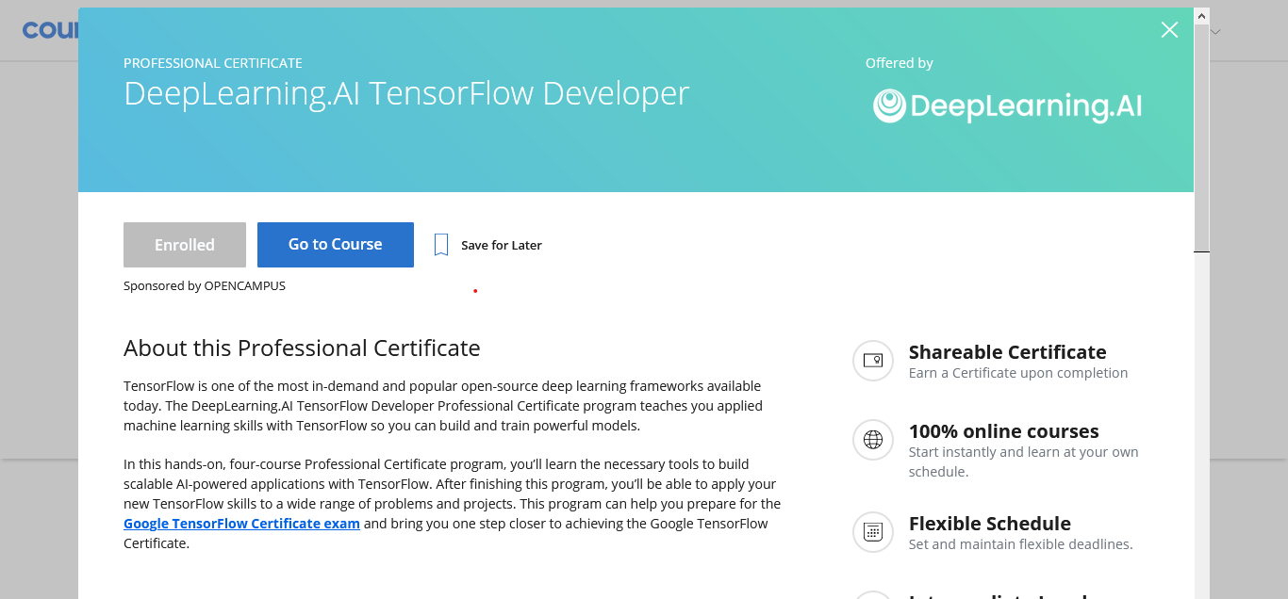

Slide 24
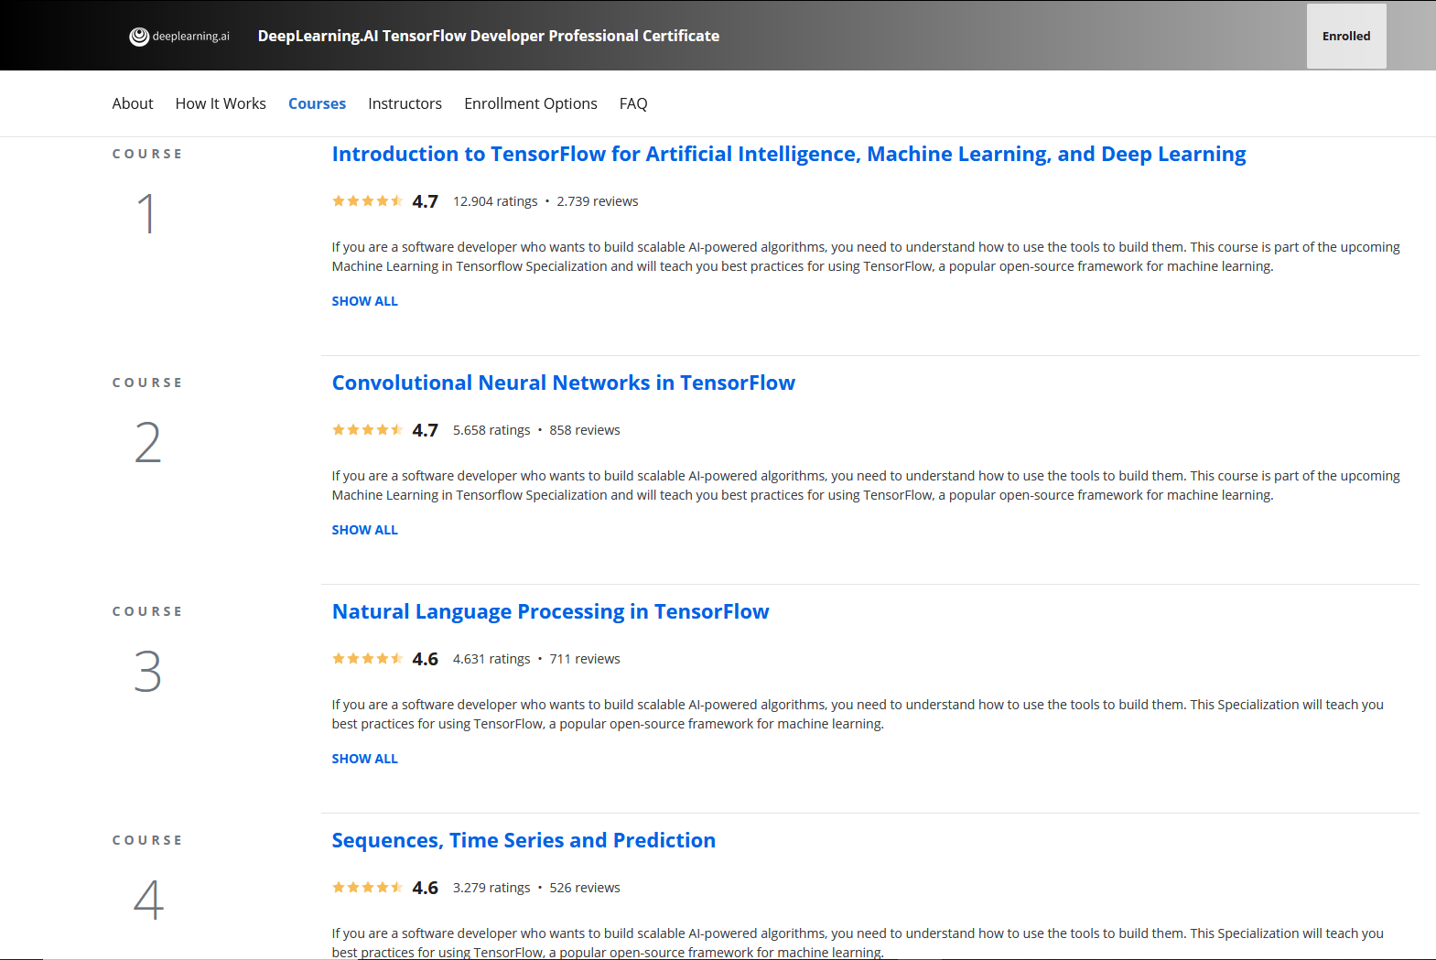

Slide 25
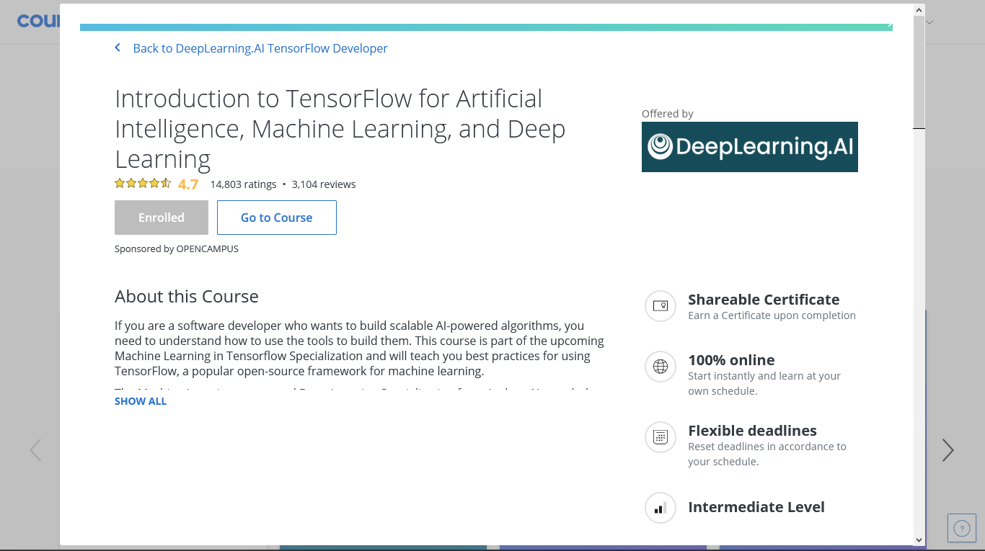

Slide 26
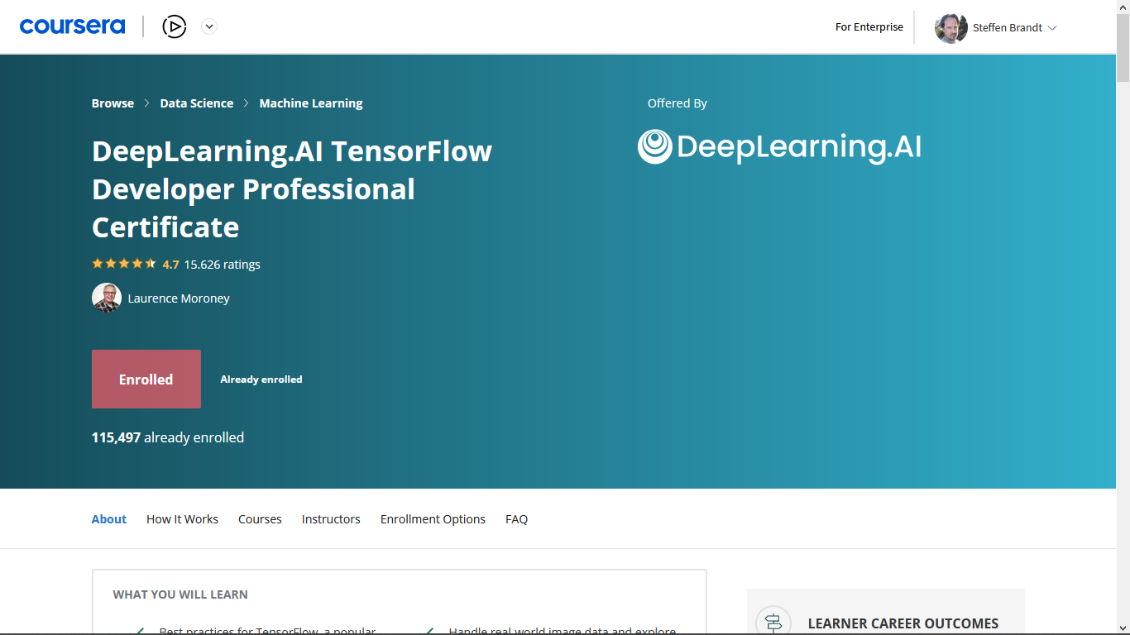

Slide 27
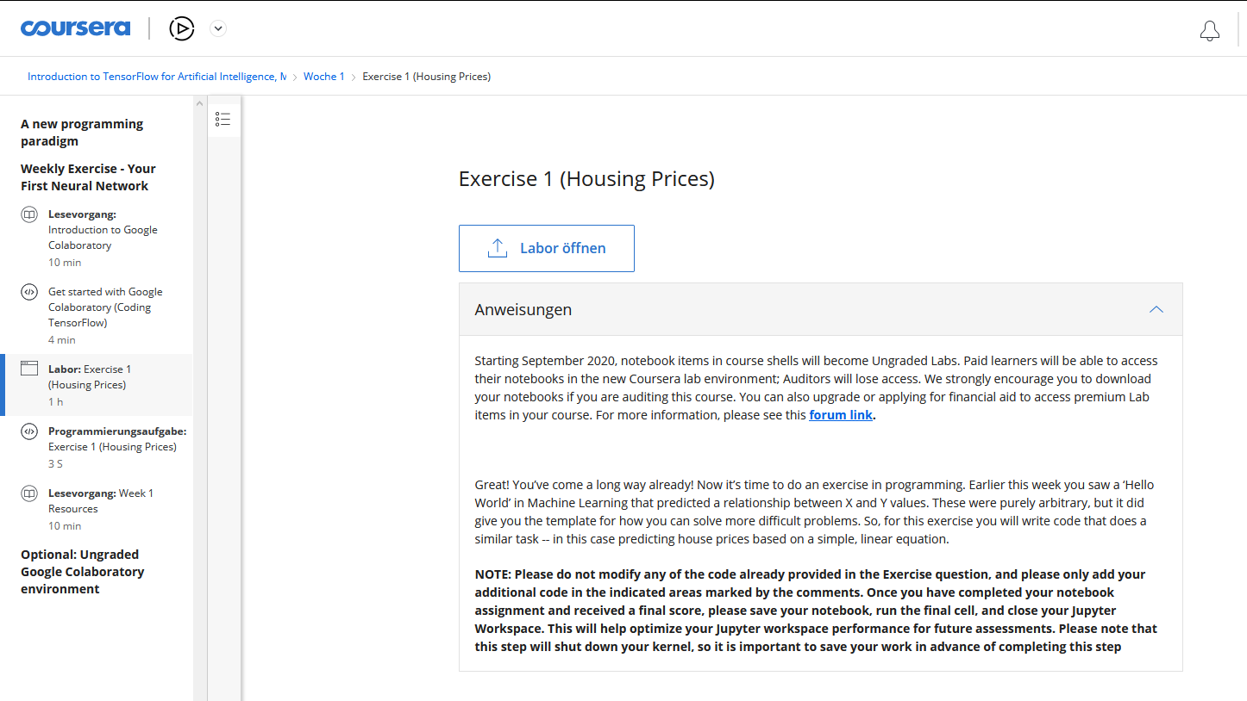
Exercises (Labs)

Slide 28
Exercises
Each week two to four of you will present the learnings from the exercises
Each of you presents at least once
Your presentation should take no longer than 6 minutes
We will provide with a template for your presentation
Notes:
Timer very important to learn the skill of quickly summing up the most important information.

Slide 29
Overcoming obstacles
Use this slide to present the challenges you faced during this exercise
Describe the process of running into a problem and how you fixed it or why the problem still remains
There are no wrong answers here, even if your problems seem trivial others might have had the same probelm and will benefit from your experience
Make sure to include some screenshots of code highlighting what you are talking about (only a few lines)

Slide 30
Unexcpected Discoveries
Use this slide to present what surprised you the most about this weeks exercise
It can be something new, you didn´t know existed before or maybe a parameter you didn´t know you could set etc.
Again there are no wrong answers here, if you can´t think of anything right away, think back to this weeks content and be creative. What exactly did you learn this week?

Slide 31
Anything else
Use this slide to talk about remaining questions or topics that stuck with you during this weeks course
If you already have a project idea you can use it to connect the exercises and talk about how the two relate
If you had another obstacle you can talk about that
It can also be something you found very importannt and want to know by heart

Slide 32
Exercises: Who will present next week?
Notes:
Usually the first ones are by far the easieast. Make it attractive to be under the first ones.

Slide 33
Projects
Option 1:
Bring your own idea and data
Option 2:
Do one of the two default projects

Slide 34
Default Project
Time series prediction
Based on sales data from a local bakery chain
Prediction of future sales for three different stores and different product groups

Slide 35
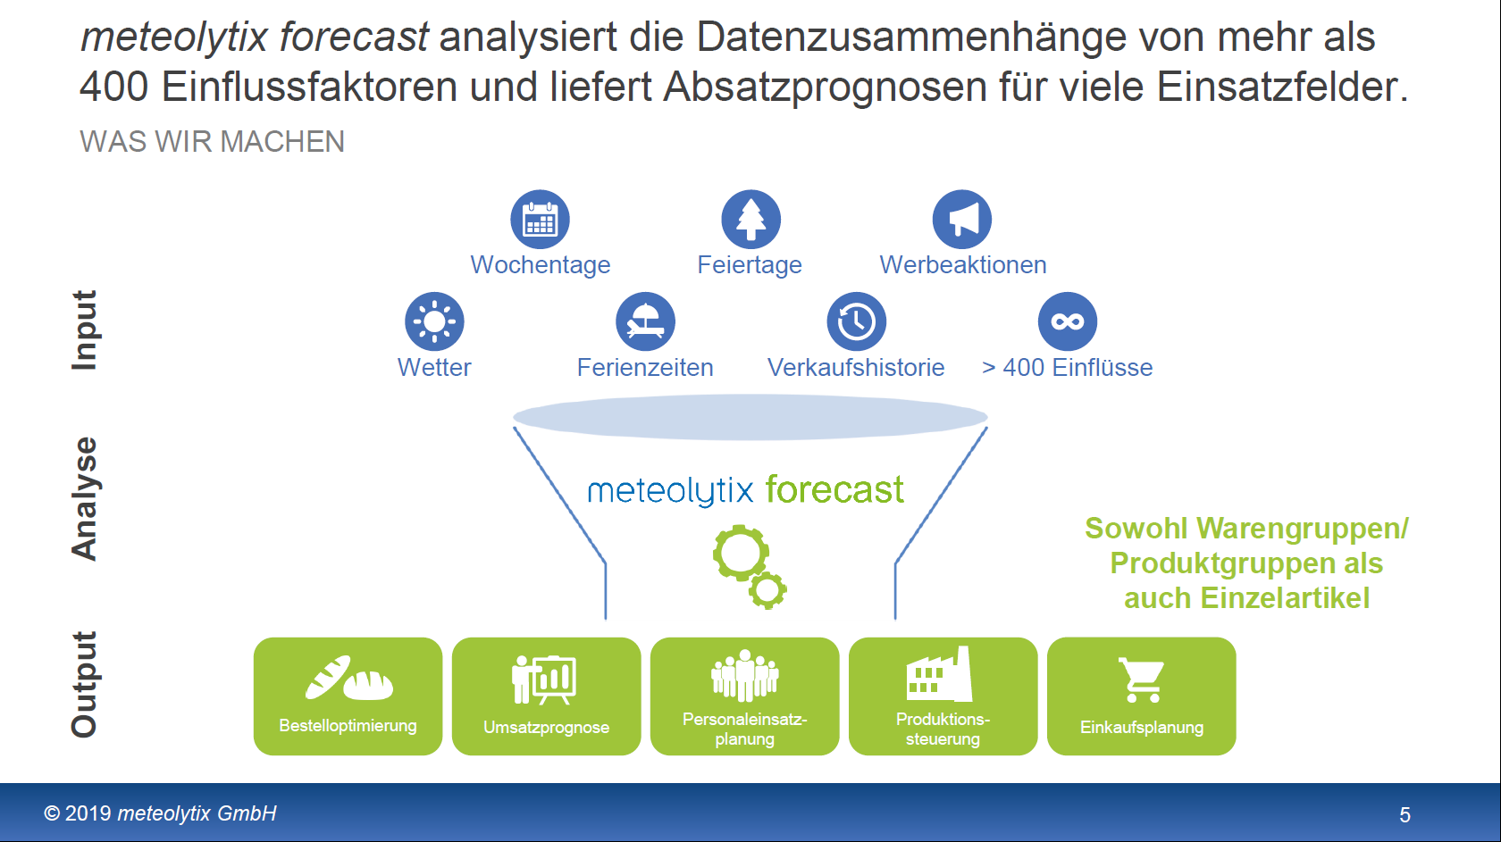

Slide 36
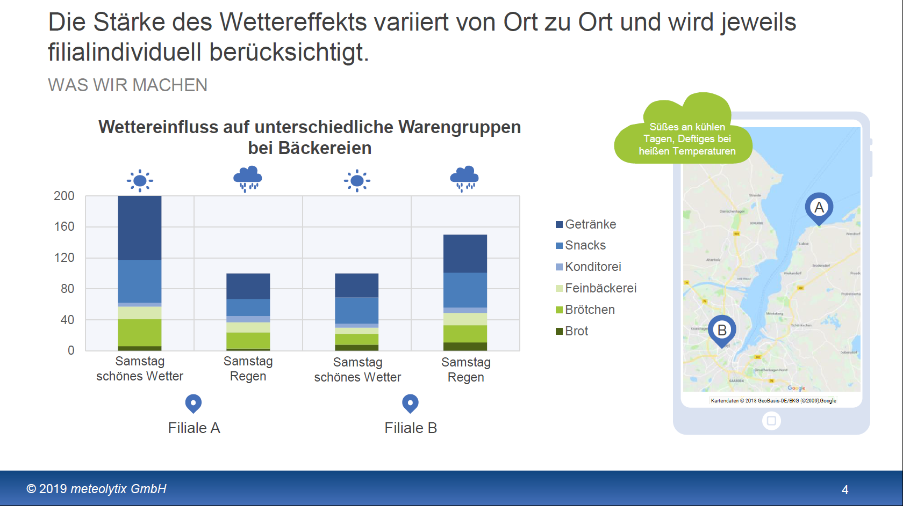

Slide 37
project interests

Slide 38
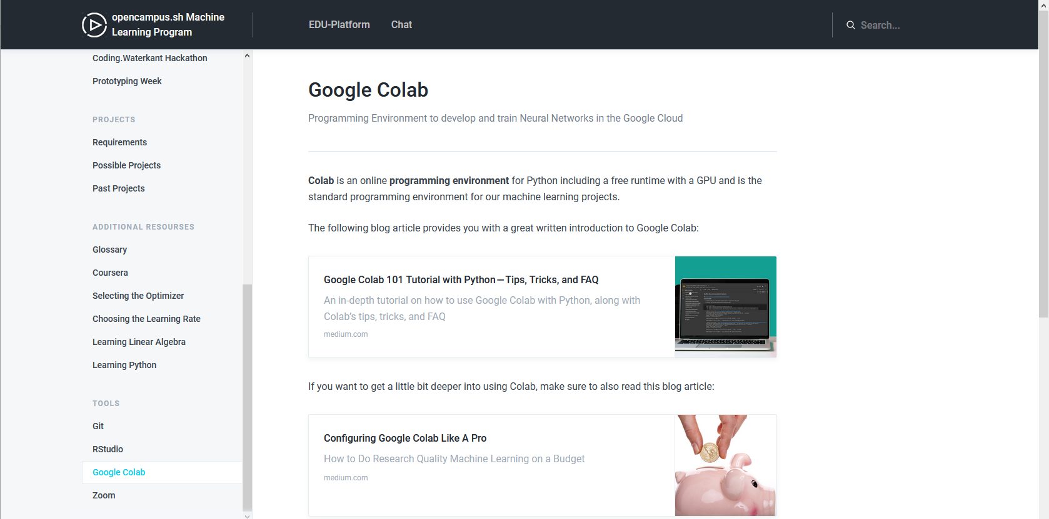
Google Colab

Slide 39
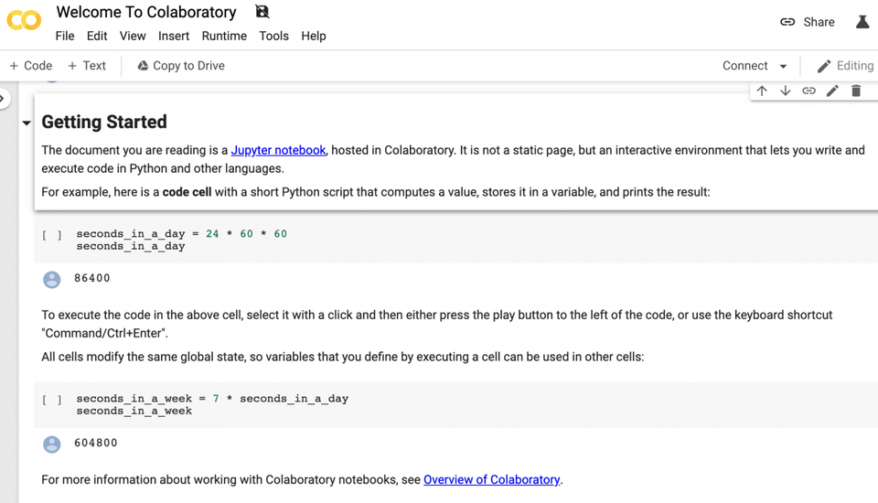

Slide 40
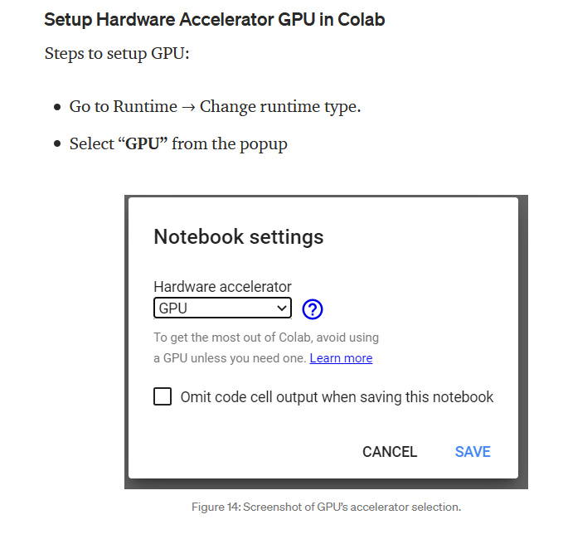

Slide 41
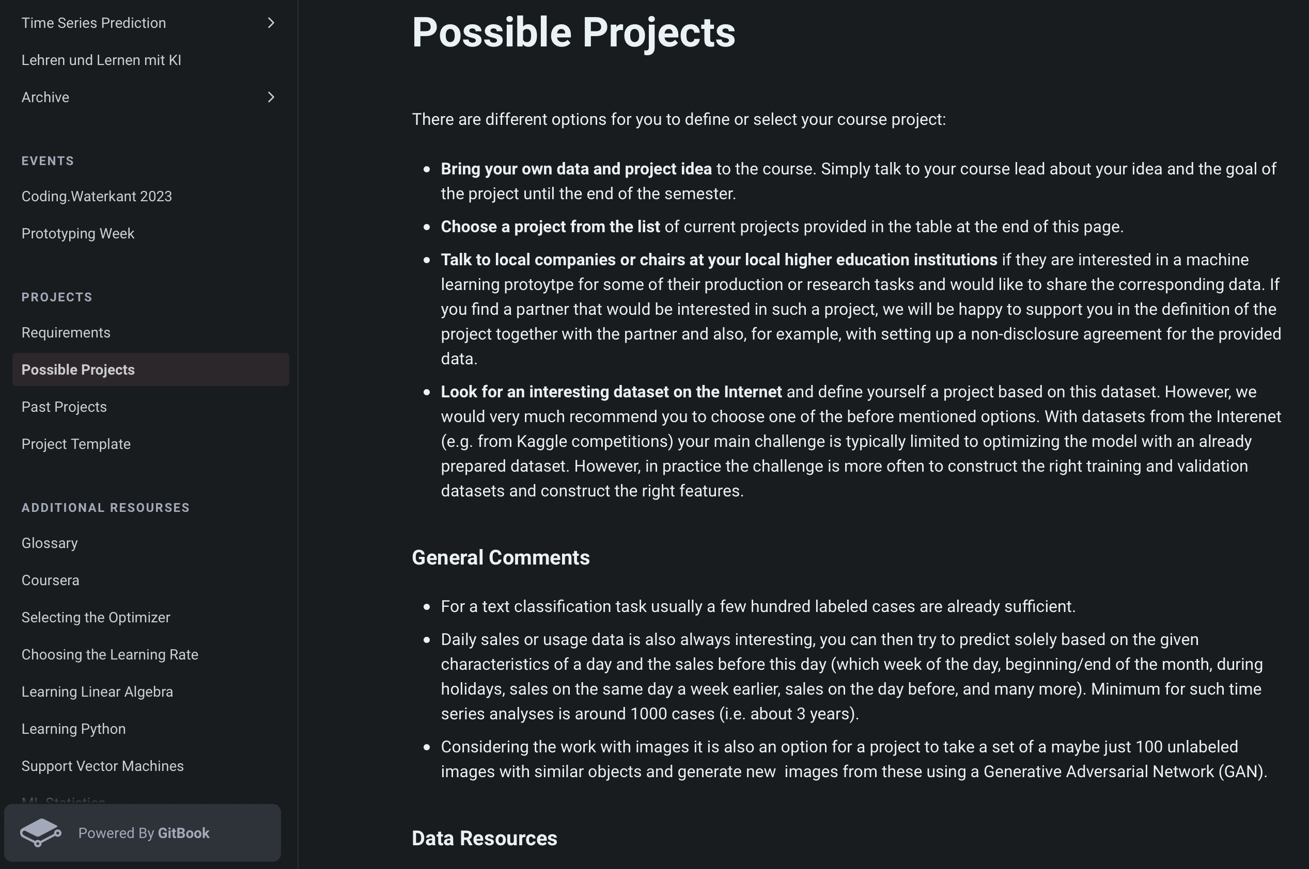

Slide 42
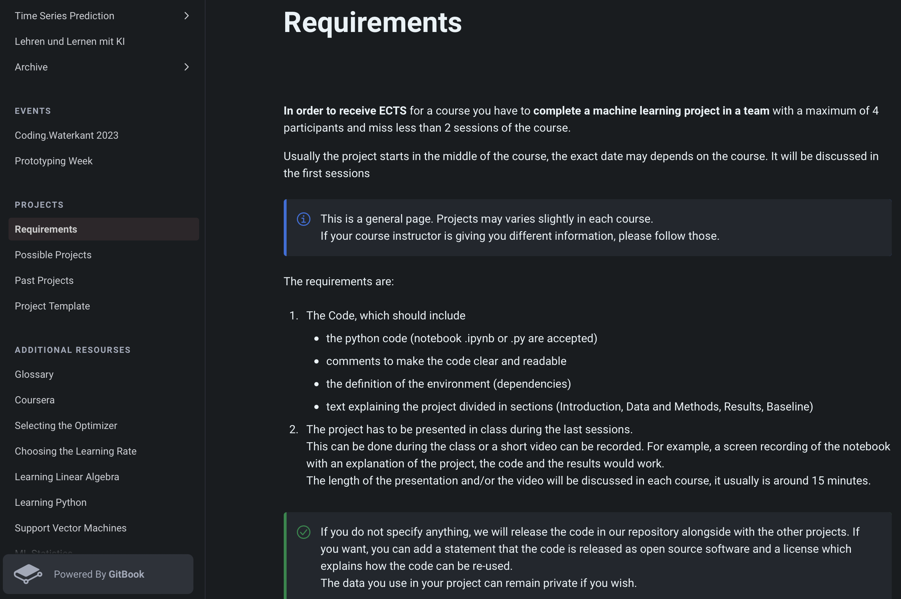

Slide 43




Notes:
TensorFlow: Used by Google [Python, C/C++, Java, Go, R, Swift, JavaScript; Keras only Python and R]
PyTorch: Used by Facebook, IBM, Yandex, and Idiap Research Institute (IDSIA), since recently now also Microsoft. Friendly programming language with useful error messages, a huge repository of sample code, guides, and a helpful community [Python]
CNTK: Is more popular in the speech recognition arena but can also be used for text and image training. Easy to use. [Python, C++, C#/.NET, Java, BrainScript]
SciKit Learn: Efficient tool for statistical modeling techniques namely classification, regression, clustering; good for data mining. [Python]
Caffe(2): Was developed for computer vision/image classification by leveraging Convolutional Neural Networks(CNNs). Caffe is popular for its Model Zoo, which is a set of pre-trained models that doesn’t require any coding to implement; used by academics and startups; Caffee2 is now part of PyTorch [Python, MATLAB, C++]
JAX: In very short it’s Numpy for GPUs.
Also see https://www.reddit.com/r/MachineLearning/comments/m3boyo/d_why_is_tensorflow_so_hated_on_and_pytorch_is/ for a nice discussion on the different frameworks.

Slide 44
Feb 2017: TensorFlow 1.0 (Estimator API)
Nov 2017: TensorFlow 1.4 (Estimator API, Keras API)
Jan 2019: TensorFlow 2.0 (Estimator API, Keras API)

Slide 45




Development EnvironmentS

Slide 46
Tasks Until Next Week
Completion of the learning material of week 1 and 2 of the course "introduction to TensorFlow“
Complete Exercises 1 and 2 given in the Coursebook
Who presents?
Bring questions!

